Slide 1
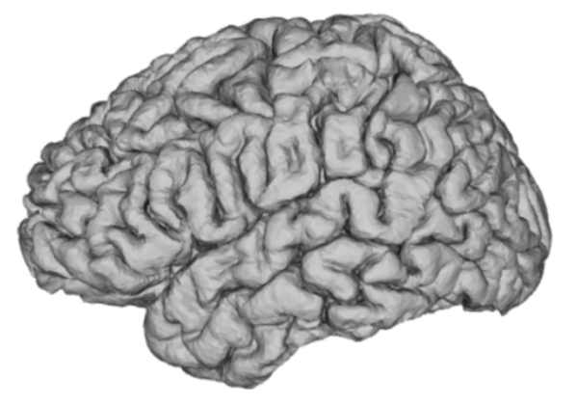
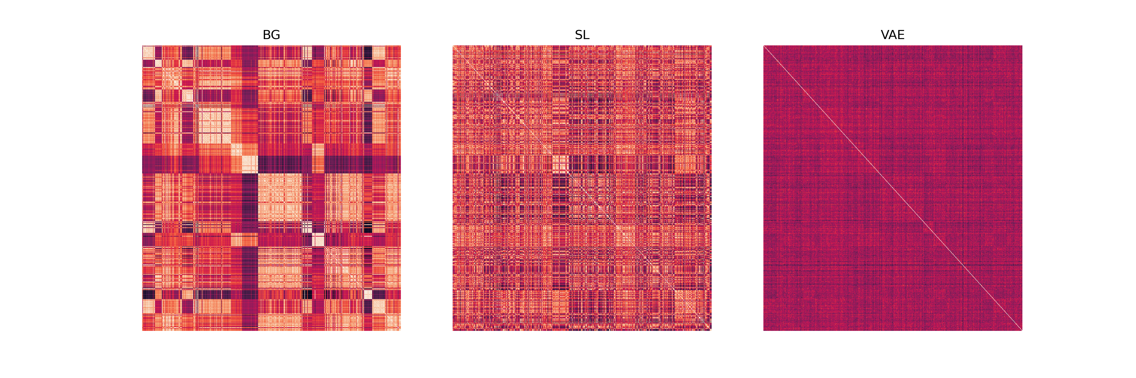
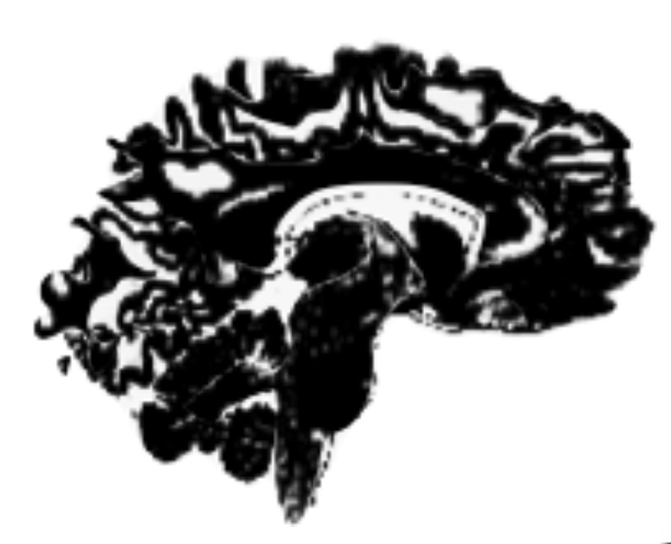
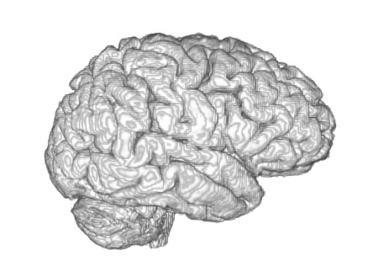
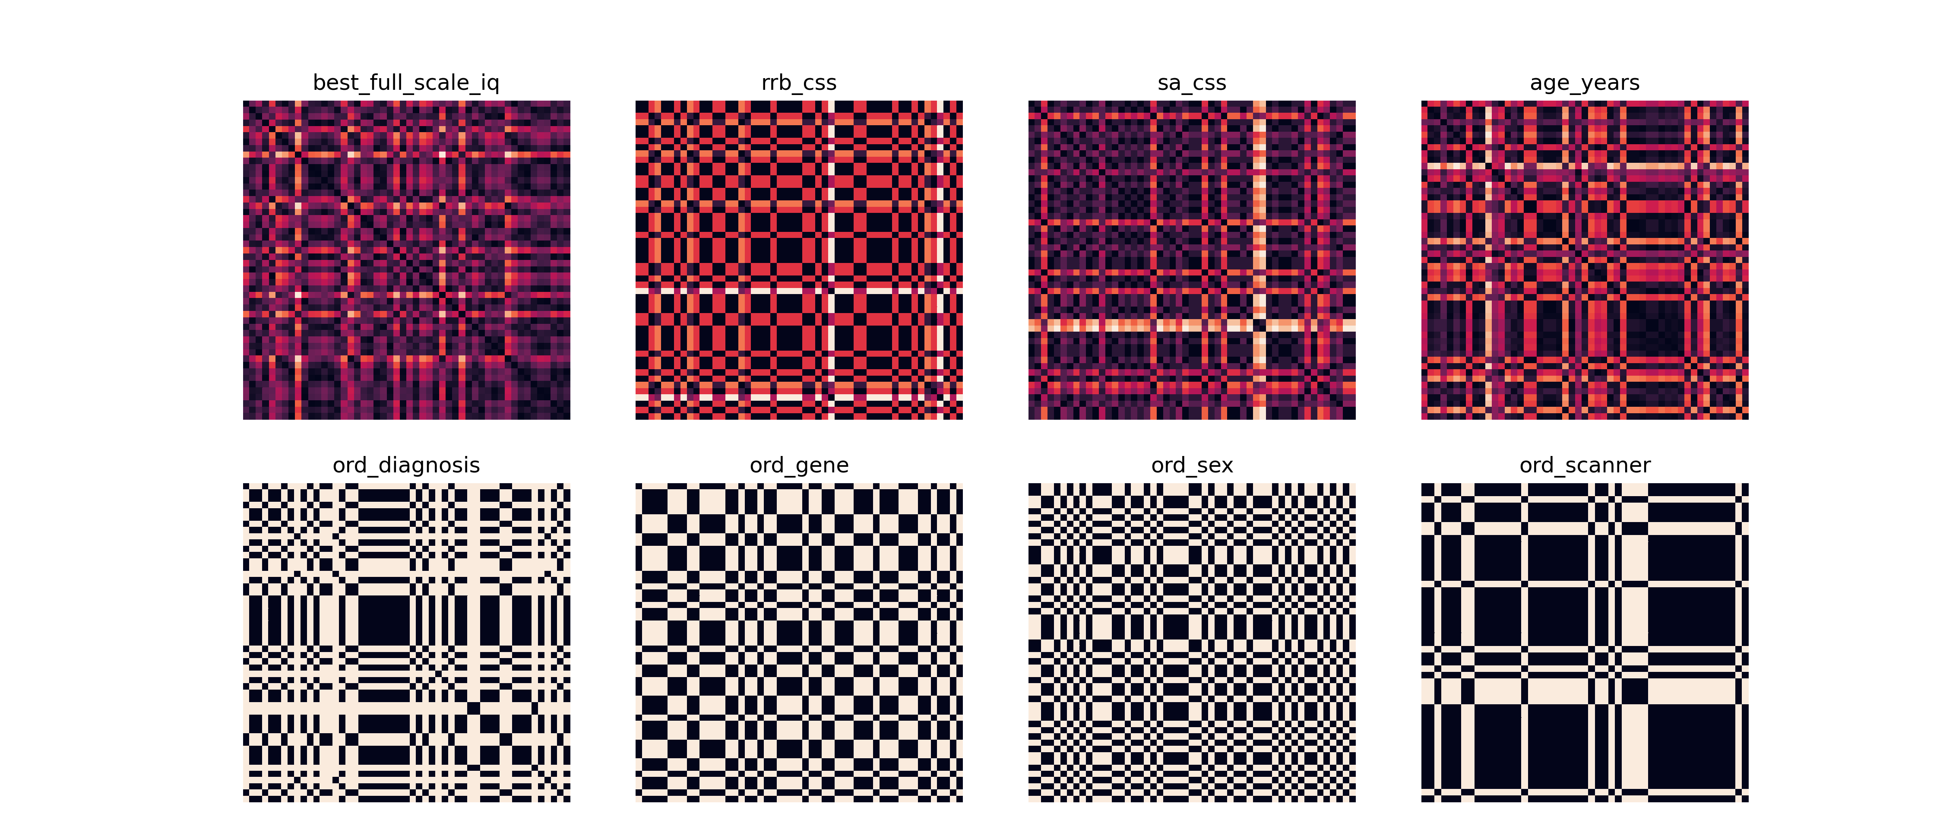
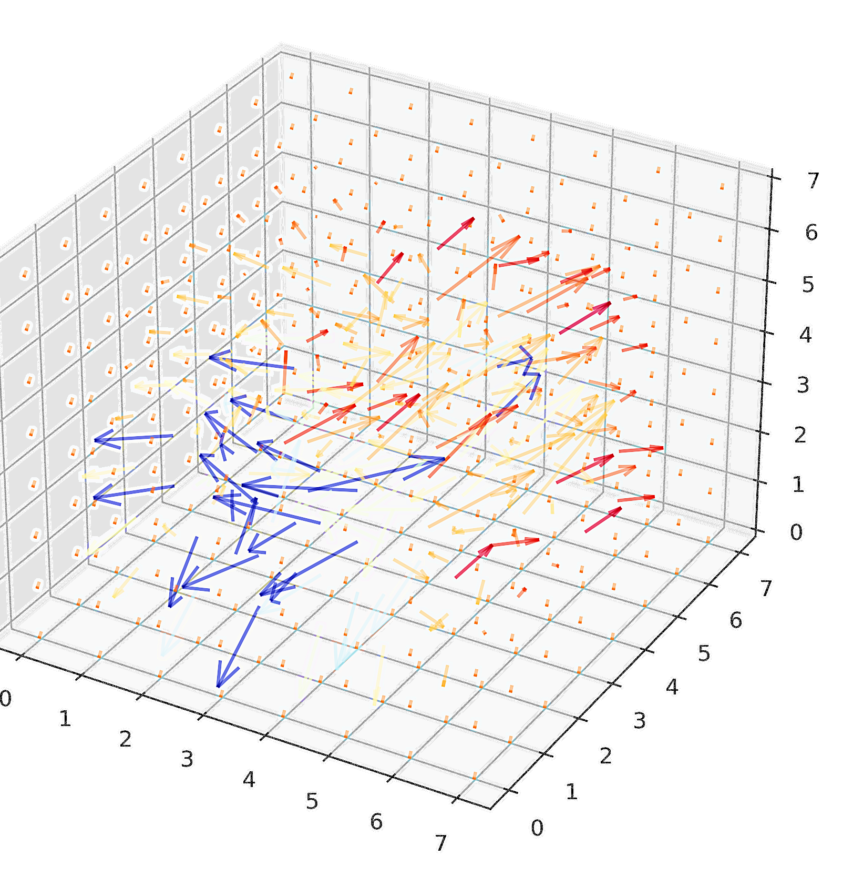
Data Preprocessing
Contrastive autoencoding
RSA analyses
Neuroanatomical
Analyses
T1w image in native space
Data path for TD input
Data path for ASD input
ASD data input (N=470)
ASD brain
ASD brain
Tissue segmentation
𝝁_{j}
𝞼_{j}
𝝁_{k}
𝞼_{k}
𝝁_{j}
𝞼_{j}
0
0
Gray Matter
White Matter
Extract subject similarity
+
BG space
SL space
Full reconstruction
Reconstruction of TD features only
Subjects
Subjects
Brain
Tissue
TD reconstruction
ASD reconstruction
Subjects
Subjects
Identification of ASD features
RSA models
ASD brain
TD features
Subject’s brain in Native space
(3D Volumetric view)
Convolutional
encoders
Shared decoder
=
+
Salient space
Background space
Spatial normalization TD -> ASD
𝝁_{k}
𝞼_{k}
𝝁_{j}
𝞼_{j}

